Slide 1
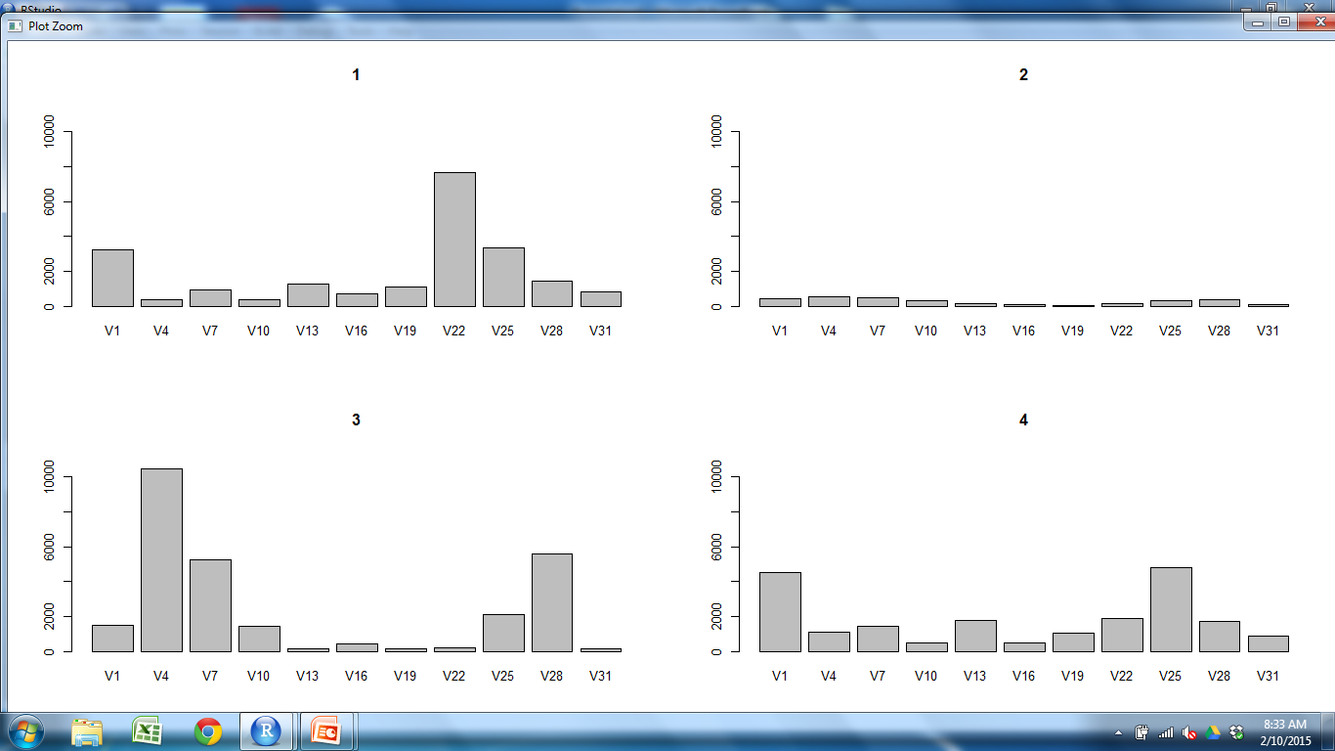
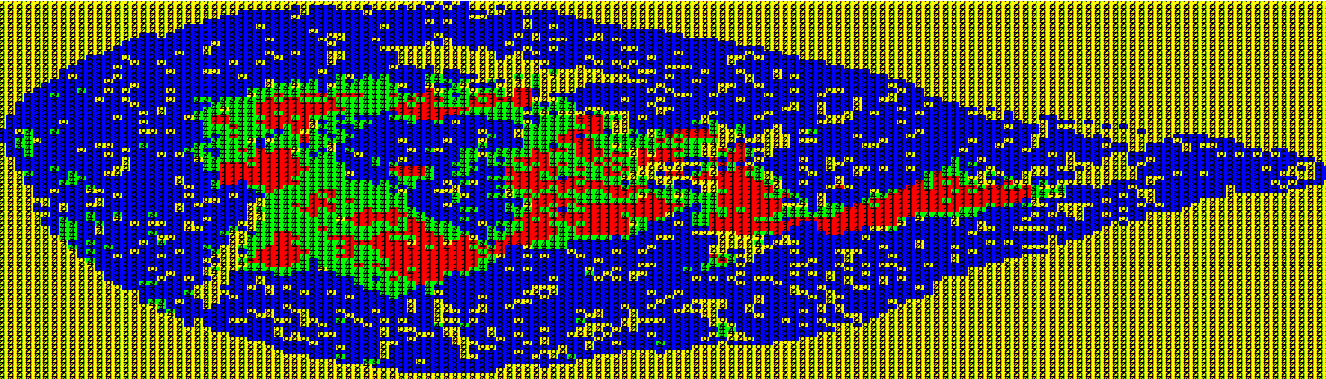
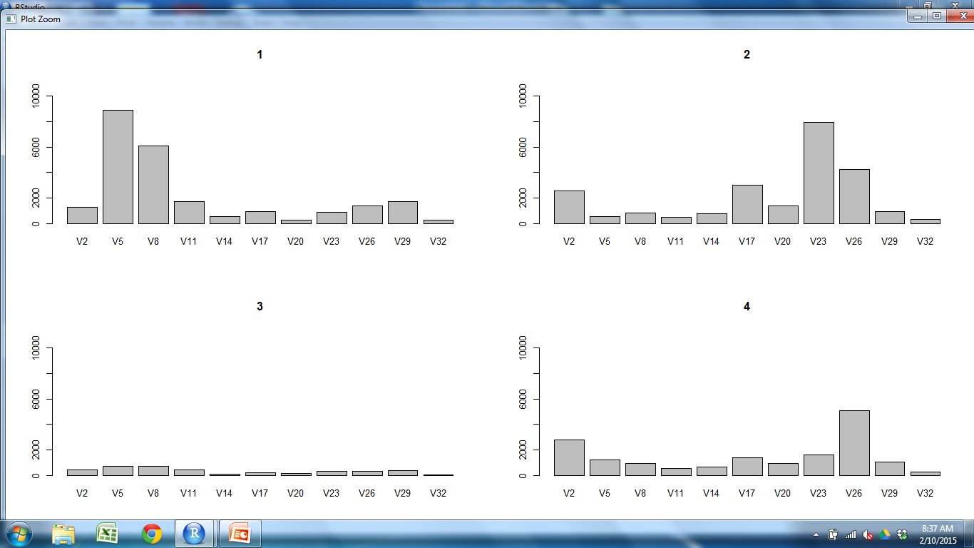
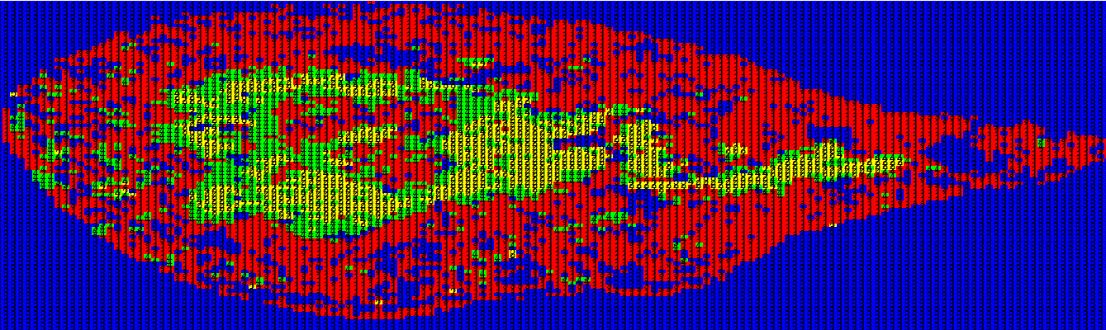
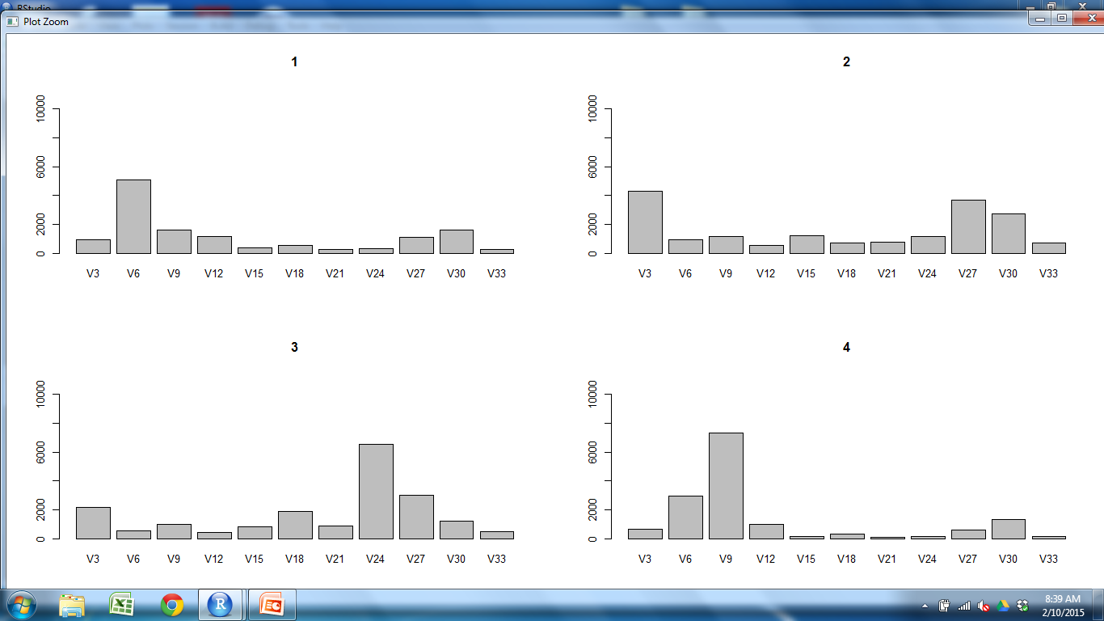
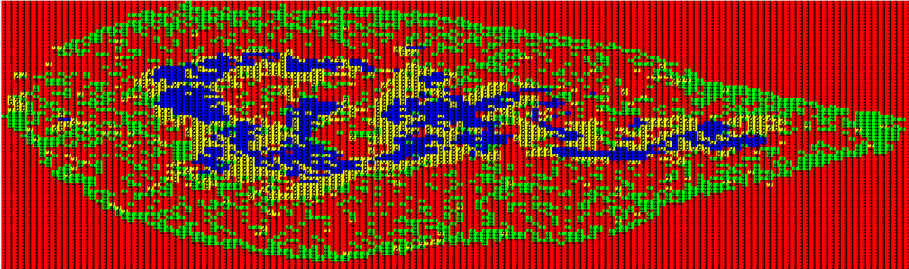
CD11c CD205 CD25 CD31 Claud34 Claud5 Foxp3 K14 K5 PDGFRb UEA1

Slide 2
CD11c CD205 CD25 CD31 Claud34 Claud5 Foxp3 K14 K5 PDGFRb UEA1

Slide 3
CD11c CD205 CD25 CD31 Claud34 Claud5 Foxp3 K14 K5 PDGFRb UEA1

Slide 4
CD11c CD205 CD25 CD31 Claud34 Claud5 Foxp3 K14 K5 PDGFRb UEA1

Slide 5
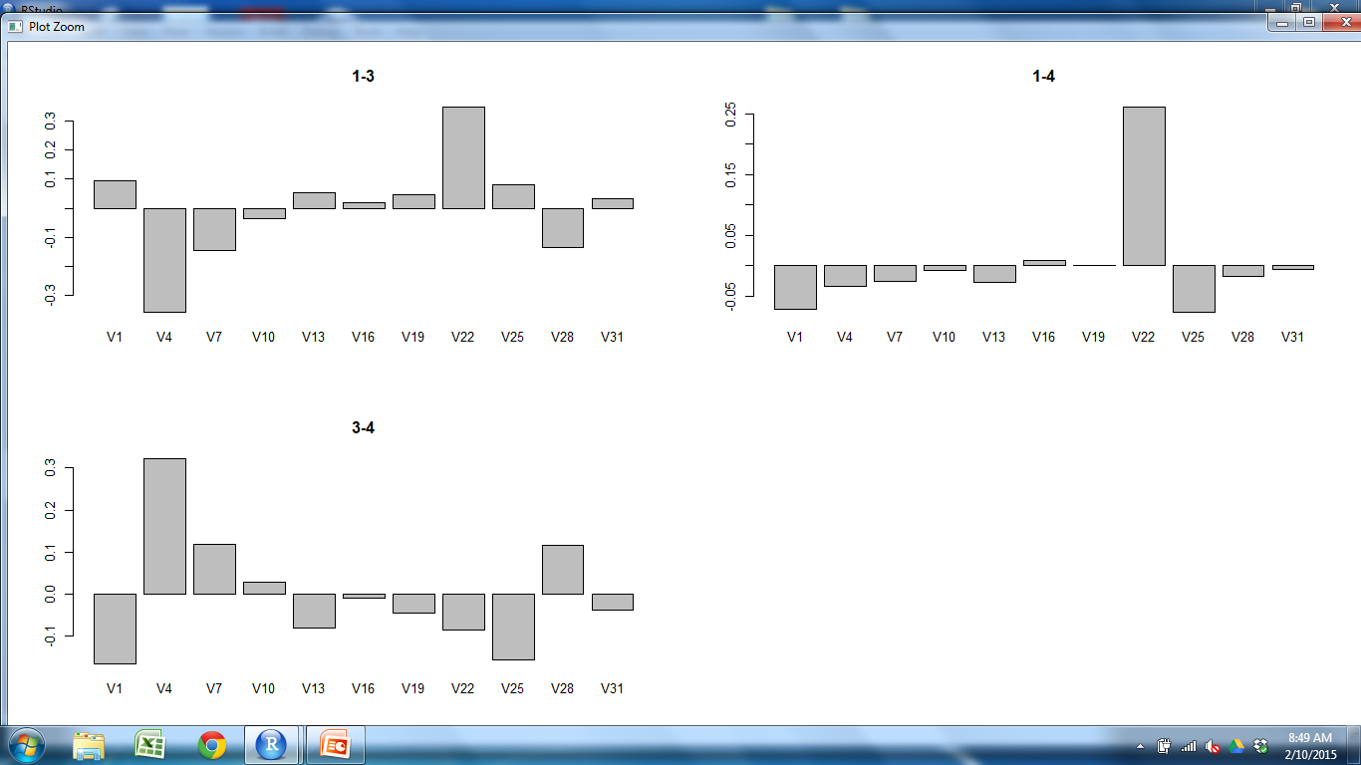
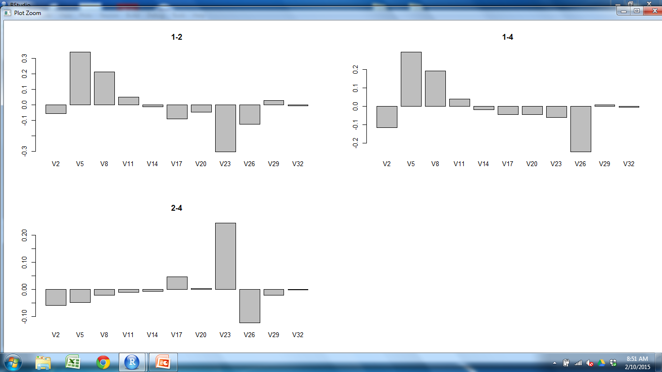
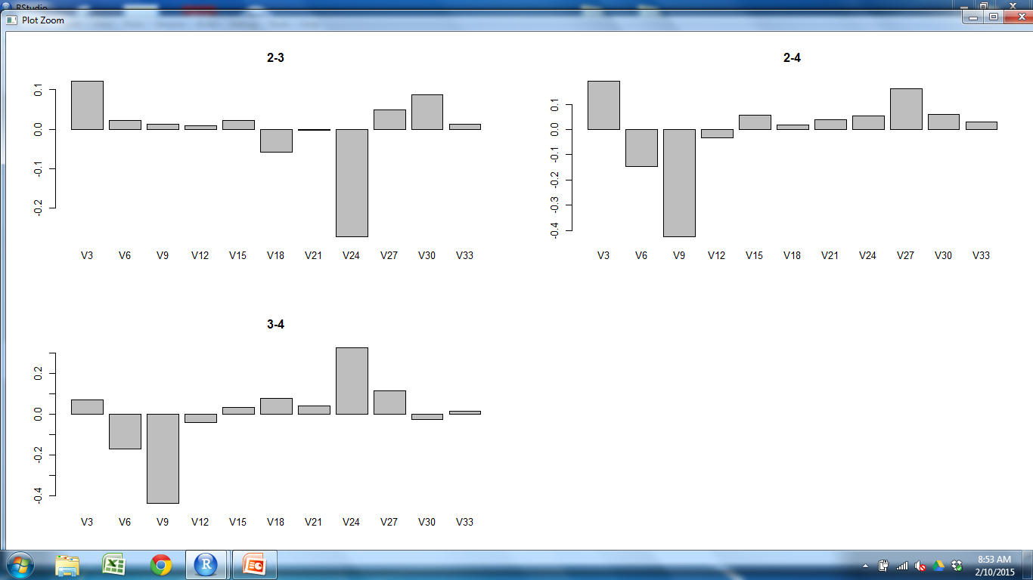
CD11c CD205 CD25 CD31 Claud34 Claud5 Foxp3 K14 K5 PDGFRb UEA1

Slide 6
CD11c CD205 CD25 CD31 Claud34 Claud5 Foxp3 K14 K5 PDGFRb UEA1

Slide 8
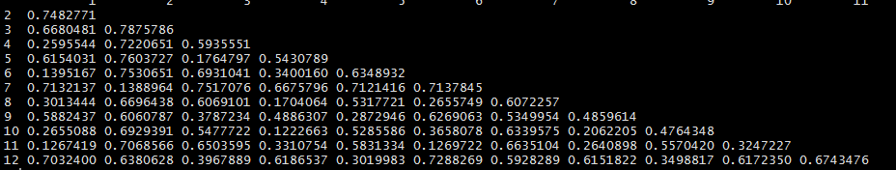
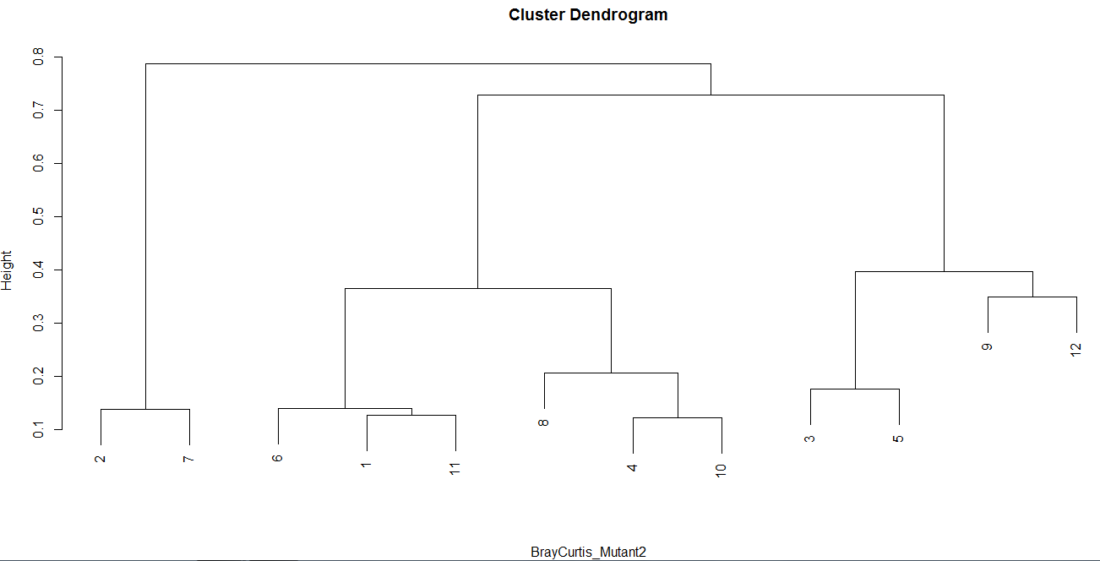
M2 Outer Cortex M1 Cortex M2 Outer M1 Outer M1 M2
Outer
Cortex
M1
Cortex
M2
Outer
M1
Outer
M1
M2
Cortex
S1Outer S2Outer S2M2 S1M2 S3M2 S2M1 S1M1 S3M1 S1Cortex S2Cortex S3Outer S3Cortex

